Slide 1

Data Mining – Meeting 3
Roi Yehoshua
Partially based on slides of Noam Koenigstein
The Open University

Slide 2
Agenda
Decision Tree Learning
Comparing Attribute Selection Measures
Tree Pruning
Discretization of Continuous Attributes

Slide 3
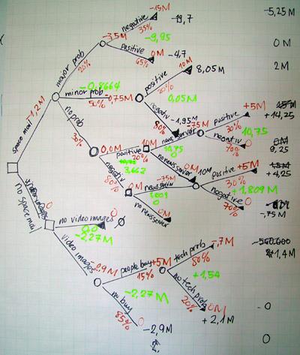
Chapter 5:
Decision Trees

Slide 4
Decision Trees
Decision tree learning is a popular classification technique
The basic decision-tree algorithm constructs a model in a top-down recursive divide-and-conquer manner
Various decistion tree algorithms differ on the tree building process – specifically on the splitting criteria, the type of branches (multiway/ binary), stopping criteria and pruning

Slide 5
Decision Tree Induction: Training Dataset
This follows an example of Quinlan’s ID3

Slide 6
Output: A Decision Tree for “buys_computer”
age?
<=30
overcast
>40
31..40
student?
yes
credit rating?
no
yes
excellent
fair
no
yes
no
yes

Slide 7
Algorithm for Decision Tree Induction
Basic algorithm (a greedy algorithm)
Tree is constructed in a top-down recursive divide-and-conquer manner
At start, all the training examples are at the root
Attributes are categorical (if continuous-valued, they are discretized in advance)
Examples are partitioned recursively based on selected attributes
Test attributes are selected on the basis of a heuristic or statistical measure (e.g., information gain)
Conditions for stopping partitioning
All samples for a given node belong to the same class
There are no remaining attributes for further partitioning – majority voting is employed for classifying the leaf
There are no samples left

Slide 8
Algorithm: Generate_decision_tree
Inputs:
D – Data partition
attributes_list – a list of available attributes
attribute_selection_method – A procedure to determine the splitting criteria
Create a node N
If tuples in D are all in the same class, C then
return N as a leaf node labeled with the class C
If attribute_list is empty then
return N as a leaf node labeled with the majority class in D
Apply attribute_selection_method(D,attribute_list) to find the “best” splitting criteria
For each outcome j of the splitting criteria
Let Dj be the set of data tuples in D the satisfy outcome j
If Dj is empty then
Attach a leaf labeled with the majority of class D to node N
Else attach the node returned by Generate_decision_tree(Dj,attribute_list) to node N
Endfor
Return N
Page 293
If splitting_attribute is descrete and multiway split is allowed
attribute_list = attribute_list – splitting_attribute

Slide 9
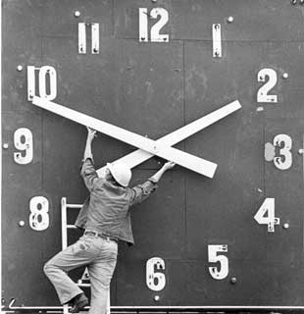

Time Complexity?
What is the tree’s depth?
What is the complexity at each level?
We get:
|D| - number of tuples
n – The number of attributes

Slide 10

Attribute Selection
Not to be confused with the preprocessing step…
We talk about splitting rules: Decide on the “best” splitting criteria
Watch out Information Theory is coming back…
Information Gain
Gain Ratio
Gini Index
Twoing Splitting

Slide 11


Information Gain
What is the uncertainty in the data?
And if we split on attribute A?
So what’s the “gain” of splitting on A?

Slide 12
The Meaning of Information Gain?
So what is the “best” splitting criteria according to the Information Gain principle? Answer: The “best” attribute is the attribute with minimum conditional entropy
This attribute has the highest information gain
This is the ID3 algorithm… Greedy…

Slide 13
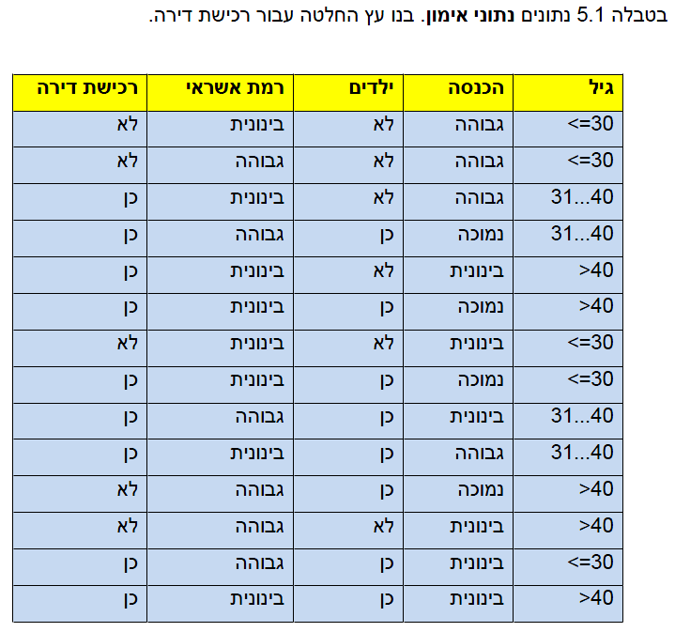
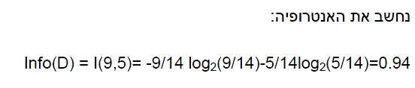

Slide 14

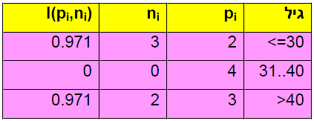


Slide 15
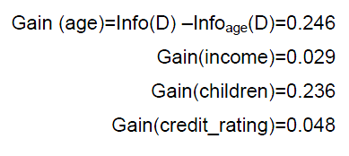
So what’s the splitting attribute?

Slide 16
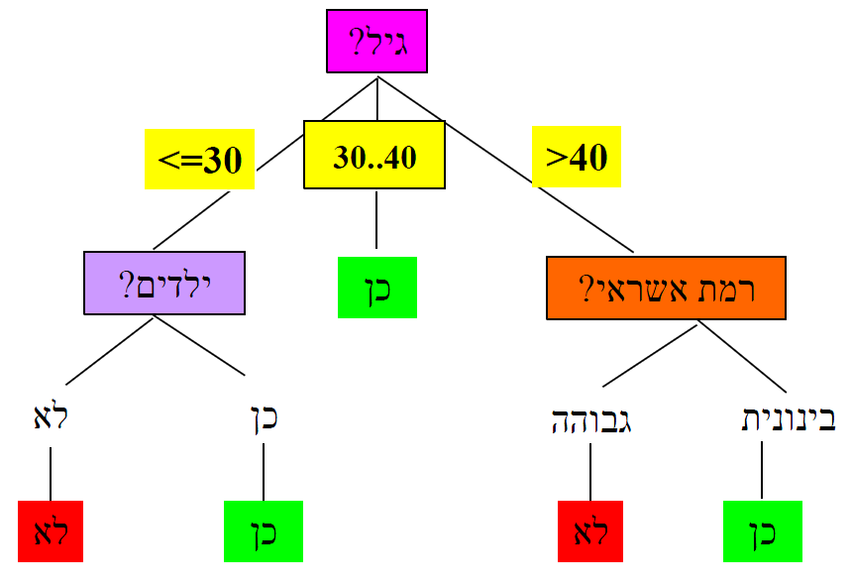

Slide 17
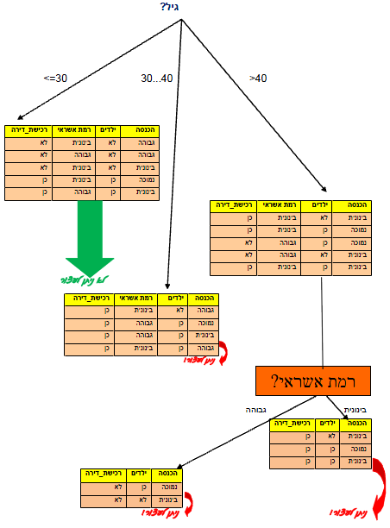

Slide 18
תרגיל (1)
נתונה טבלת נתוני אימון (ראו בשקף הבא)
בנו עץ החלטה חלקי, הכולל את רמת השורש ורמה אחת נוספת בלבד, עבור נתוני האימון שבטבלה לחיזוי החלטה האם העובד יקודם במקום עבודתו.
בתשובתכם הדגימו את שלבי בחירת התכונה המפצלת בעץ.
איזה מבין התכונות ניתן להסיר ומדוע? אם אין תכונה הניתנת להסרה, יש לציין זאת מפורשות.

Slide 19
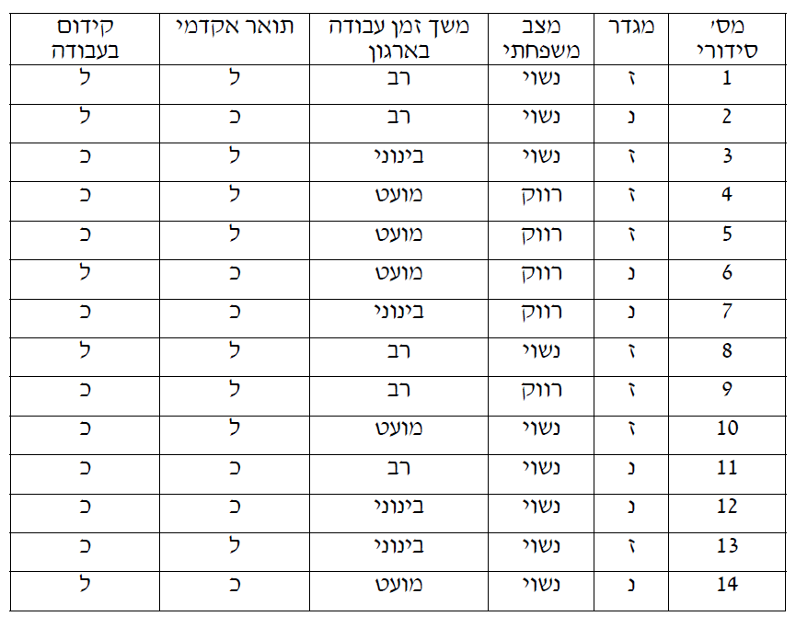
תרגיל (1)

Slide 20
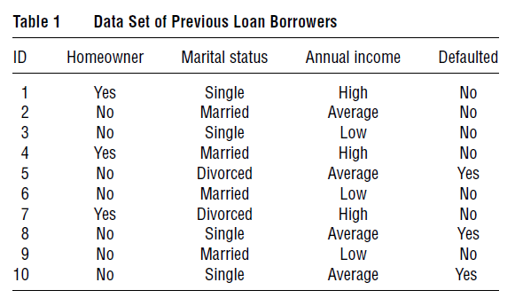
תרגיל (2)
Build a decision tree for the following data
(table adapted from Tan et al. 2006)

